Slide 1
Coding and Billing 2021 E/M Knowledge Assessment & Massachusetts Legislative Updates
Shawn Bromley
NEPHO
Wednesday, January 13, 2021
Disclaimer: This presentation is offered as guidance to NEPHO providers and office administration. If you are a BILH employed practice please follow up with your practice Leadership on guidance reviewed during this presentation.

Slide 2
Agenda
Welcome 2021 Coding and Billing
2021 Evaluation and Management (E/M) Change Knowledge Assessment
2021 E/M Review
7 Tips to Follow to Better Support Compliance
Time Leveling Documentation Examples
Medical Decision Making (MDM) Documentation Examples
Prolong Service Code Update
Telehealth Review
Telehealth Documentation Review
Patient Experience Survey
Out of State Licensing Guidance
Massachusetts Strengthen Telehealth Services
Rate Parity for Telehealth
COVID 19 Testing and Treatment Updates

Slide 3
Welcome 2021 Coding and Billing
New E/M updates effective January 1, 2021
Diagnosis codes reset on January 1, 2021 (recapture for all chronic conditions for 2021)
New fee schedules will be updated for 2021 (reimbursement)
COVID 19 Phase 1A – Now to End of February Focus of the Department of Public Health (DPH)
Vaccine Administrative Code
91302
0021 A – first dose
0022 A – second dose
Payers are supporting patient vaccine efforts

Slide 4
Evaluation and Management (E/M) Updates – Knowledge Assessment
What service area have been affected by the new E/M updates?
Inpatient Services *Behavioral Services *Emergency (ED) *Outpatient/Clinic Services
What elements have been eliminated as key components?
History *Exam *Review of Systems (ROS) *History & Exam
What E/M code has been deleted due to these updates?
99211 *99201 *99417 *99215
What key element has been added in 2021 as a key component for time calculation?
Non-Face-to-Face Time *Face-to-Face with Family Member *Discussion with Specialist
What is the definition for “Independent Historian”?
A person who provides history other than patient *A parent *A Witness *All 3
What prolong service codes have been added in 2021 and what is the time limit?
99417/20 minutes *99217/15 minutes *99417/10 minutes *99417 /15 minutes

Slide 5
7 Tips To Better Support New E/M Leveling
Avoid Generic Documentation: If a provider reviews medical records they should document the specific records, from whom (specialist), and the dates of services.
Describe Diagnosis Management: To get credit for diagnosis management in the new MDM table, providers need to link each diagnosis with some type of action—a prescription, test, counseling or some other type of workup. Stating that the diagnosis is managed by another provider doesn’t count.
Document Compliantly: Be mindful of total time spent. For example, a provider sees 20 patients a day and documents that they spend 35 minutes per patient, totaling approximately 12 hours. This exceeds a typical eight-hour workday and could be a red flag for a payers.
Pay Attention to Services Rendered: For example, a provider reviews lab results two days after an encounter. They can’t count this time toward the E/M level for the previous visit to which the labs pertain. However, they may be able to report CPT codes 99358 and 99359 for prolonged services on a date other than the date of a face-to-face encounter
Do not Bill Services Separately Reportable: If a physician performs an ECG interpretation and report, they can’t apply that toward the E/M level because separate CPT codes exist (93000, 93005 and 93010)
Include Social Determinant of Health (SDOH): Capturing SDOH via ICD-10-CM diagnosis codes (e.g., Z59.0 for homelessness or Z59.5 for extreme poverty) may help support a more complex MDM and thus a higher-level E/M code.
Support Medical Necessity: It will be hard to support 50 minutes with a patient with strep throat. Remember each Clinical scenario is unique and documentation should support the clinical reason for visit.

Slide 6
Overview of Changes
Remove history and exam as key components – code descriptor “which requires a medically appropriate history and/or examination”
Code selection based on MDM or time
99201– will be deleted
99211 – same requirements – no components need to be met and physician presence is not required (nurse visits)
99202 & 99212– Straightforward
99203 & 99213 – Low
99204 & 99214 – Moderate
99205 & 99215 – High

Slide 7
Visit Time Range Updates
New Patient Codes
99202: 15-29 minutes
99203: 30-44 minutes
99204: 45-59 minutes
99205: 60-74 minutes
Established Patient Codes
99211: Outlier
99212: 10-19 minutes
99213: 20-29 minutes
99214: 30-39 minutes
99215: 40-54 minutes

Slide 8
Time Redefined
Face-to-face time to total time spent on the day of the encounter
Will help to clarify when more than one provider is involved
Total time will include:
Preparing to see the patient (review of tests, prior medical visits)
Obtaining and/or reviewing separately obtained history (established patient)
Performing the medically appropriate exam and/or evaluation
Interpreting results and/or communicating results to the patient/family/caregiver
Care coordination (not separately reported)

Slide 9
MDM Updates
Revision of MDM definitions
Number and Complexity of Problems Addressed
Amount and/or Complexity of Data to be Reviewed and Analyzed
Risk of Complications and/or Morbidity or Mortality of Patient Management
There will be a new table for calculating medical decision-making
“Number of diagnosis or management options” will become “Number and complexity of problems addressed”
“Amount and/or complexity of data to be reviewed” will become “Amount and/or complexity of data to be reviewed and analyzed”
“Risk of complications and/or morbidity or mortality” will become “Risk of complications and/or morbidity or mortality of patient management”

Slide 10
Documentation Examples Primary Care
Chief complaint: Patient presents for visit due to fall related to fever and blurry vision, patient has been feeling weak and is experiencing chills. Patient presents with spouse who offers additional history related the patient’s current condition.
The patient is an established patient with prior history obtained – there are no changes in the patient history (PFSH, living environment & medical history)
Leveling based off time:
The provider spent 10 minutes prior to the visit reviewing the patient history and chronic conditions: 10 minutes
The provider meets with the patient and spouse face-to-face for 20 minutes, reviews current health status and confirms with patient and spouse that there have been family stressors that have caused issues with low blood sugar affecting diabetes management: 20 minutes
The provider reaches out to the patients endocrinologist to set up an appointment to discuss potential monitoring devices to help manage blood sugar levels: 10 minutes
Total visit time: 40 minutes day of encounter – patient visits supports 99215
Leveling based off MDM:
1 or more chronic illnesses with exacerbation, progression, or side effects of treatment (Diabetes)
Anxiety/Stress – new problem
Discussion of management of care for Diabetes and Stress
Patient visit supports 99214 (moderate risk)

Slide 11
Documentation Examples Asthma & Allergy
Leveling based off MDM:
Established patient is seen for follow-up to recheck asthma. The patient was seen 3 months ago and asthma was normal. Today there is a flare up that patient states began yesterday. Patient denies headaches.
Exam: General: No acute distress, pleasant, alert, and oriented times 3. Speech is normal. Voice is normal. WT: 129. BP: Right arm 175/69, left arm 168/62. HR: 84. TEMP: 97.8. Chest: There is high effort in breathing. Heart: Rate seems high, and patient states there is tightness in chest. Moves all extremities with 5/5 strength. No edema. Skin: there are no signs of rash
Provider reviews prior spirometry results
Provider will be referring patient to pulmonary to review asthma and potential lung condition
The number and complexity of problems addressed here are low
The patient has one exacerbated, chronic condition
The allergist reviewed the spirometry results and referred to pulmonary
Data is solid and level of risk is moderate
Patient visit supports 99214 (moderate risk)

Slide 12
Prolong Service Code
A major component of the 2021 E/M changes is the introduction of CPT prolong service code 99417 (an official CPT code number will be assigned at a later date) effective January 1, 2021.
The code reflects a “prolonged office or other E/M service that requires at least 15 minutes or more of total time either with or without direct patient contact on the date of the primary E/M service (either CPT codes 99205 or 99215)”.
CPT 99417 Code may only be reported in conjunction with 99205 or 99215 if the codes were selected based on the time alone and not medical decision making. A service of less than 15 minutes should not be reported.
For example: Existing prolonged E/M code + 99354 will change to specify that you should not report the code in conjunction with 99202-99215

Slide 13
Telehealth Documentation Examples
Document plan of care for chronic conditions, condition status
Example: AFib I48.91 – heart rate within normal limits, converting back to normal sinus rhythm, apixaban is helping to regulate heart rate
Chronic conditions need to be captured/recaptured annually
Example: Depression (F33.8) or depression in remission (F33.4), Opioid dependence (F11.20) or opioid dependence in remission (F11.21) (Depression: when depression has stabilized coding depression in remission would be appropriate)
Chronic conditions should be discussed and documented during a new patient visit
Example: New patient visit with the following chronic conditions: Hypertension I10, CKD stage 3 N18.32 stage 3b, Recurrent depressive disorder F33.8, Opioid dependence in remission F11.21
Document confirmed chronic conditions to their highest specificity
Example: Diabetes with CKD stage 3: E11.22, N18.3 1 stage 3a (1st code diabetes with chronic kidney disease then code chronic kidney disease)

Slide 14
Telehealth Exam Components Capture
Exam components to help support a Telehealth exam:
HEENT: Use a flashlight or phone based light to look at the throat and nose
Skin: Have the patient press on a rash to observe any scaling or redness
Cardiovascular: Find pulses at the radial, carotid, femoral and jugular venous
Abdominal exam: Have the patient feel for masses and/or describe location of symptoms such as pain
Musculoskeletal: Self palpitation can be used to show locations of pain or point of tenderness. Range of motion can be assessed and directed by the provider
Neurologic: Observe patient gait, have them squat and get up and down from a chair and/or walk across the room
Have the patient be more involved and interactive in the visit, have patient family members or care giver offer additional information to better support the reason for the visit. Include their information in the note to help support the visit medical necessity.

Slide 15
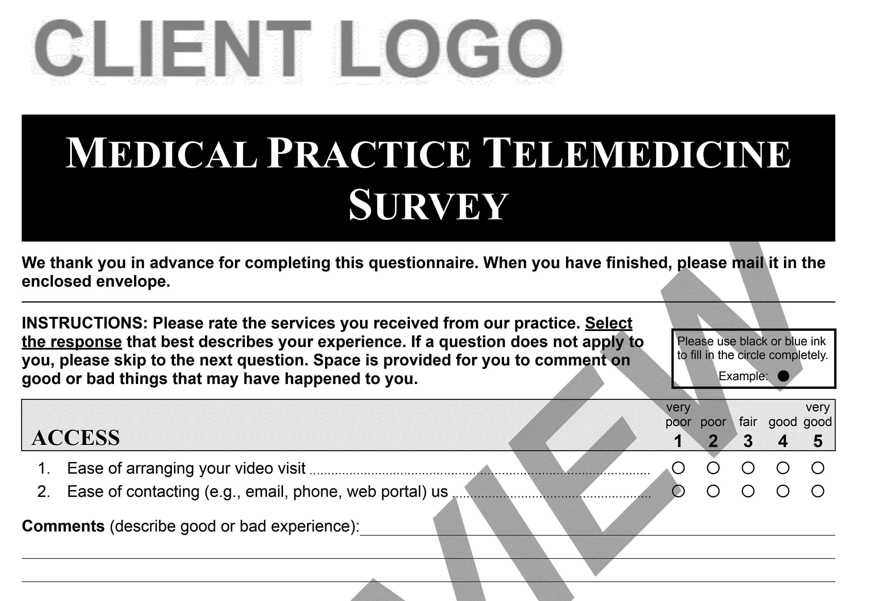
Patient Experience Survey Review

Slide 16
Patient Experience Survey Review (continued)

Slide 17
Patient Experience Survey Review (continued)

Slide 18
Out of State Licensing Guidance
We urge each provider to be licensed in the state where the patient is located, unless there are provisions in place otherwise due to the pandemic.
Keep a continuous eye on the changes for each state that you are seeing patients in and do not hold a license to practice, as changes are fluent.
Federation of State Medical Boards that provides guidance by state, as each state has put in place their own rules and regulations in response to the pandemic - https://www.fsmb.org/siteassets/advocacy/pdf/states-waiving-licensure-requirements-for-telehealth-in-response-to-covid-19.pdf
The FSMB website breaks down state specifics surrounding out-of-state physicians; pre existing provider-patient relationships; audio-only requirements; etc.

Slide 19
Our Recommendations
Before the pandemic, seeing patients across state lines via telehealth without being licensed in the state the patient was physically sitting in was considered practicing without a license. The dust is still settling - although telehealth is the new normal, state medical boards will continue drive their own rules and regulations.
We recommend you begin to analyze patient data to determine where your patients are living to best determine the states that each provider would benefit in obtaining a state license within.
Additional licensing guidance can be found at: https://www.nepho.org/nepho-out-of-state-licensing-guidance/

Slide 20
Massachusetts Legislative Bill Signed 1/1/2021
Strengthening Telehealth Coverage: Mandates permanent payment parity for Behavioral Health services and established parity for Primary Care and Chronic Care Management for the next two years.
Currently Audio only and E/M (face-to-face) are being reimbursed equally – this bill will help keep this balance in place as we move past the pandemic.
It requires payers to cover all such services delivered via telehealth that are also offered in-person, and to reimburse providers at the same rate.
Permanent Expansion for scope of practice for NPs, Nurse Anesthetists, Psychiatric Nurse Mental Health Specialists & Optometrists.
Protects consumers from surprise billing – the bill requires providers to notify patients if procedure is in or out of network – There is work being done to have a default rate for out-of-network billing by 9/1/2021.

Slide 21
Massachusetts Legislative Bill (continued)
Improve coverage for COVID 19 Testing and Treatment – this improvement will include asymptomatic individuals.
This bill is a shift from episodic care to care management, and it will help embrace preventive care measures that improve long-term health outcomes and reduce waste and excessive use. This will help lower visits to urgent care and Emergency Room.
This bill will better support chronic care management to patients with conditions such as; diabetes, vascular disease, weight management, and mental health.
This bill will help address areas of gaps in patient care management.
Increase access to urgent care for MassHealth and eliminate referral requirements.

Slide 22
COVID 19 Vaccine & Testing Updates
The DPH is reviewing options to have Vaccine Pop-Up Sites
There needs to be a workflow process in place to ensure 2nd vaccine is given in the necessary time frame (21 days)
Hospitals and Organizations need to be flexible with patient care and flexible in treating patients with COVID 19
Phase 1 Vaccine: December 2020 to February 2021
Phase 2 Vaccine: February 2021 to March 2021
Phase 3 Vaccine: General Public – Starting April 2021
The vaccine is being provided at no charge
The Division of Insurance (DOI) has required all payers to cover members who need to have COVID 19 testing – as this will help prevent the spread of the disease
The DOI is supporting testing across Massachusetts to ensure all individuals stay safe and healthy

Slide 23
NEPHO Coding Support
Shawn Bromley @ shawn.m.bromley@lahey.org or 978-236-1704
Helpful Resources:
https://emuniversity.com/
https://www.mass.gov/info-details/covid-19-vaccine-frequently-asked-questions
https://www.mass.gov/info-details/massachusetts-covid-19-vaccine-information
https://mhealthintelligence.com/news/baker-signs-massachusetts-telehealth-bill-with-parity-provisions-into-law

