Slide 1
Sneak Peek at Coding and Billing 2022
Shawn Bromley & Jessica Bryan
NEPHO
Wednesday, July 14th, 2021
Disclaimer: This presentation is offered as guidance to NEPHO providers and office administration. If you are a BILH employed practice please follow up with your practice Leadership on guidance reviewed during this presentation.

Slide 2
Agenda
Highlights 2021 Coding & Billing
Telehealth Past the Pandemic
Review HIPAA Compliance
Licensing Requirement Review
Telehealth Service Expansion Medicare 2021-2022
Massachusetts Payer Updates
ICD-10 2022 Updates
Effective October 1, 2021
Potential Biannual Updates Beginning 2022
Social Determinants of Health (SDOH) Review
CPT 2022 Updates
Effective January 1, 2022
Resources

Slide 3
2021 Coding & Billing Highlights
ICD-10 2021 Updates
New Codes COVID 19
New Chapter – Chapter 22
Evaluation and Management Updates 2021
First Updates in 24 Years
COVID 19 Pandemic Impacts
National & State Telehealth Expansion
Patient Access To Healthcare
Audio Only Telehealth Visits
Reimbursement Changes
Coding and Billing Rules and Regulations Changes
Risk Adjustment Coding Capture 2020

Slide 4
Agenda
Recap 2021 Updates
Telehealth Past the Pandemic
Review HIPAA Compliance
Licensing Requirement Review
Telehealth Service Expansion Medicare 2021-2022
Massachusetts Payer Updates
ICD-10 2022 Updates
Effective October 1, 2021
Potential Biannual Updates Beginning 2022
Social Determinants of Health (SDOH) Review
CPT 2022 Updates
Effective January 1, 2022
Resources

Slide 5
Telehealth Past the Pandemic
Are the telehealth professionals licensed in the state where patient located? Are there practice standards for patient examinations and remote prescribing?
Are professionals documenting and maintaining patient records of the encounters?
Does insurance policy cover telehealth services?
Is insurance carrier licensed in every state where services are provided (patient located)?
https://www.fsmb.org/siteassets/advocacy/pdf/states-waiving-licensure-requirements-for-telehealth-in-response-to-covid-19.pdf
Does the informed consent form account for services provided via telehealth?
Does is recognize patient freedom of choice?

Slide 6
Telehealth Past the Pandemic (continued)
“If you didn't document it, it's the same as if you didn't do it." Anyone who enters anything into a patient encounter must make sure the documentation is detailed, accurate and thorough. Telehealth is no exception; complete and accurate documentation for the patient condition is a requirement for good patient care and to ensure proper reimbursement for services provided.
Audio Only Codes
Codes: 99441, 99442, 99443 - non face-to-face telephone only (Audio Only)
99441: 5-10 minutes of discussion
99442: 11-20 minutes of discussion
99443: 21-30 minutes of discussion

Slide 7
Telehealth Past the Pandemic (continued)
Four Main Categories:
1. HIPAA flexibility: This change allows physicians and other health care providers to use any “non-public facing” (i.e., theoretically accessible only to those invited) video conferencing technology, even if it does not meet the usual HIPAA privacy, security, and breach notification rules. This has allowed patients and clinicians to connect for telehealth visits via common applications like FaceTime and Facebook Messenger Video.
2. Medicare and Medicaid policies: The Centers for Medicare & Medicaid Services has instituted several changes that directly affect reimbursement for telehealth, including the following:
Recognizing a patient's home as an originating site,
Expanding eligibility to all Medicare recipients, not just those who live in rural areas,
Allowing telehealth visits for new patients, in addition to established patients,
Expanding recognized provider types, such as physical therapists,
Recognizing Federally Qualified Health Centers (FQHCs) and Rural Health Centers (RHCs) as the distant (provider) site in a telehealth encounter,
Allowing audio-only telehealth.
State-by-state Medicaid policies have also changed extensively, with a similar focus on expanding provider types and originating sites.
3. Licensure requirements: Multiple states have allowed temporary licenses to physicians licensed in other states to increase access to care via telehealth during the pandemic. Additionally, for licensed physicians providing specific COVID-19 countermeasures, licensure requirements have been waived.
4. Prescribing controlled substances: Prescribers are now allowed to prescribe controlled substances to patients regardless of location, and qualified prescribers can initiate buprenorphine treatment for opiate use disorder via both audio-only or audiovisual telehealth visits.

Slide 8
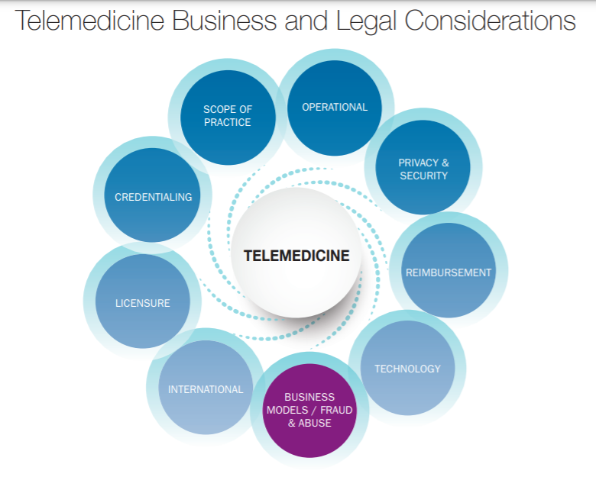
Telehealth Past the Pandemic (continued)

Slide 9
Agenda
Recap 2021 Updates
Telehealth Past the Pandemic
Review HIPAA Compliance
Licensing Requirement Review
Telehealth Service Expansion Medicare 2021-2022
Massachusetts Payer Updates
ICD-10 2022 Updates
Effective October 1, 2021
Potential Biannual Updates Beginning 2022
Social Determinants of Health (SDOH) Review
CPT 2022 Updates
Effective January 1, 2022
Resources

Slide 10
ICD-10 2022 Updates
On April 27, the Inpatient Prospective Payment System (IPPS) released 205 proposed ICD-10-CM changes to set take effect on October 1, 2021. The proposed updates include 153 new diagnosis codes, 22 revised codes, and 30 invalidated codes.
Proposed Biannual Updates in 2022 – October 1, 2021 & April 1, 2022.
Top Highlights in this update include:
New COVID-19 Codes that were recently added: including J12.82, M35.81, M35.89, Z11.52, Z20.822, and Z86.16.
Chapter 13 accounts for 35 ICD-10-CM code changes, including an update to the diagnosis code for low back pain (M54.5). It has been expanded to distinguish vertebrogenic low back pain (M54.51) from other types of low back pain.
Several changes were made in Chapter 18; six new specific codes for coughs (R05) were added, including acute, subacute, chronic, cough syncope, other specified and unspecified.
Most changes occurred in Chapter 19, including new codes for traumatic brain compression (S06.A-) and poisoning by cannabis (T40.71-) and synthetic cannabinoids (T40.72-).

Slide 11
Social Determinants of Health (SDOH) Overview
The following list provides examples of the social determinants of health, which can influence health equity in positive and negative ways:
Income and social protection
Education
Unemployment and job insecurity
Working life conditions
Food insecurity
Housing, basic amenities and the environment
Early childhood development
Social inclusion and non-discrimination
Structural conflict
Access to affordable health services of decent quality

Slide 12
SDOH Overview (continued)
Inequities in health are socially determined, preventing poorer populations from moving up in society and making the most of their potential.
Pursuing health equity means striving for the highest possible standard of health for all people and giving special attention to the needs of those at greatest risk of poor health, based on social conditions.
Action requires not only equitable access to healthcare but also means working outside the healthcare system to address broader social well-being and development.
“Health equity is defined as the absence of unfair and avoidable or remediable differences in health among population groups defined socially, economically, demographically or geographically”.

Slide 13
Agenda
Recap 2021 Updates
Telehealth Past the Pandemic
Review HIPAA Compliance
Licensing Requirement Review
Telehealth Service Expansion Medicare 2021-2022
Massachusetts Payer Updates
ICD-10 2022 Updates
Effective October 1, 2021
Potential Biannual Updates Beginning 2022
Social Determinants of Health (SDOH) Review
CPT 2022 Updates
Effective January 1, 2022
Resources

Slide 14
CPT 2022 Updates
Inpatient and Observation Services Codes 99217-99226 may be deleted, and language added to the initial and subsequent inpatient codes, 99221-99223 and 99231-99233, for observation hospital E&M services. This would be a revision to the latter, as the observation codes are reimbursed poorly for a patient who may be in the “observation hospital unit” for up to 48 hours – or longer. This could be for payment parity for hospital patients. This change looks to be more favorable to the physician than the facility coding piece, as a change in definition from observation to inpatient could affect reimbursement, from Outpatient Prospective Payment System (OPPS) capitated claims to per-diem hospital reimbursement. This would take effect Jan. 1, 2023.
Consultation Services, Inpatient and Outpatient Codes 99251 and 99241 are proposed to be deleted by 2023, in keeping with the seldom-reported Level 1 services. We already saw this change for 2021 with the office and other outpatient visits, and the deletion of the Level 1 new patient office visit, 99201, so this change was expected.

Slide 15
CPT 2022 Updates (continued)
Emergency Department Visits Codes 99281-99285 look to be getting a language revision of the code descriptor, but the change was not clear in the proposal.
Home Health and Residence E&M Encounters It appears that this section has many repetitive or similar codes in the portions that include home health, domiciliary care, rest home, and assisted living care. The proposal looks to streamline these services into a single tabbed section for home health services. This makes sense and should be approved for revision by Jan. 1, 2023.
Prolonged Services Several new codes look as though they could be added into this section, along with a revision of the new 99417, to include non-face-to-face time on the same date – to enhance accuracy when added to the Level 5 Office or Other Outpatient Visits, 99205 or 99215. This update would take effect by January 2023, although I could see this being updated by 2022 based on necessity for a sooner clarification, because this new 2021 add-on code is already being reported. It is also proposed to delete the existing prolonged services codes 99354-99357, as they are not permitted with office visits in 2021.

Slide 16
Resources
Shawn Bromley, NEPHO Director Contracting and Operations – Lead Coding Initiatives – shawn.m.bromley@lahey.org or 978-236-1704
Jessica Bryan, NEPHO Coder – jessica.m.bryan@lahey.org
https://www.homestatehealth.com/content/dam/centene/home-state-health/pdfs/HSH_AWVGuide_HealthHistorySummary.pdf
https://www.azcompletehealth.com/content/dam/centene/az-complete-health/pdf/provider/news_items/508_Annual%20Wellness.pdf
https://www.medicare.gov/coverage/yearly-wellness-visits
https://www.who.int/health-topics/social-determinants-of-health#tab=tab_3
https://www.kff.org/racial-equity-and-health-policy/issue-brief/beyond-health-care-the-role-of-social-determinants-in-promoting-health-and-health-equity/

